Slide 1
Highest Grossing Hollywood Movies
Choosing the Next Box Office Hit

Slide 2
Our Hypotheses:
American Influence Remains Strong ✅
International sales follow domestic (US) sales
“Goldilocks” Ratings & Runtime Are Most Popular 📊
Certain sweet spots exist for genre and runtime
A Handful of Studios Dominate the Box Office ✅
Economies of scale give incumbents the advantage

Slide 3
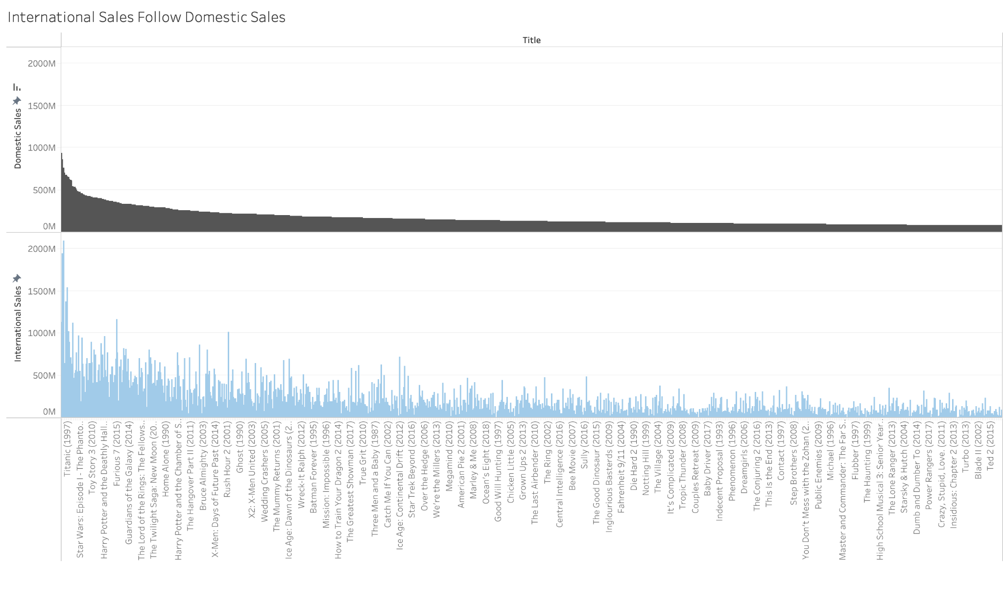
International Market Follows Domestic Trends

Slide 4
Outliers:
Franchises
International markets favour big franchises like Avengers and Bond disproportionately
Comedies
Comedies (Liar Liar, Mrs. Doubtfire, Meet The Fockers) underperform with international audiences, likely due to language nuances

Slide 5
Recommendations Based on Findings:
Continue Domestic Focus
International sales will follow once a film does well in the US.
International Specialization:
Use franchise films to draw international markets, avoid comedies

Slide 6
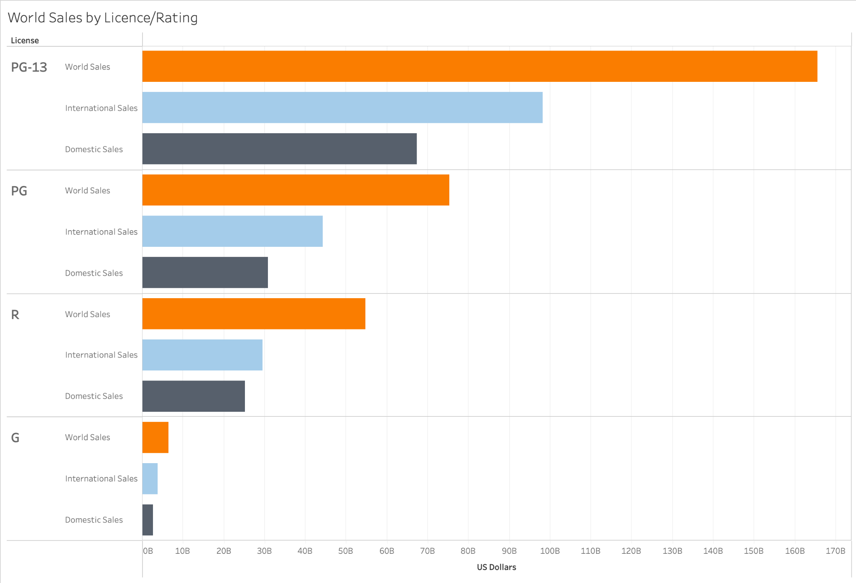
Audiences Prefer ‘Middle-of-the-Road’ Ratings (PG-13, PG)

Slide 7
Outliers: None
Stay Mainstream
Children’s movies (G ratings) and horror/other R rated films can’t compete with films that appeal to all age groups and demographics
Recommendations Based on Findings:

Slide 8
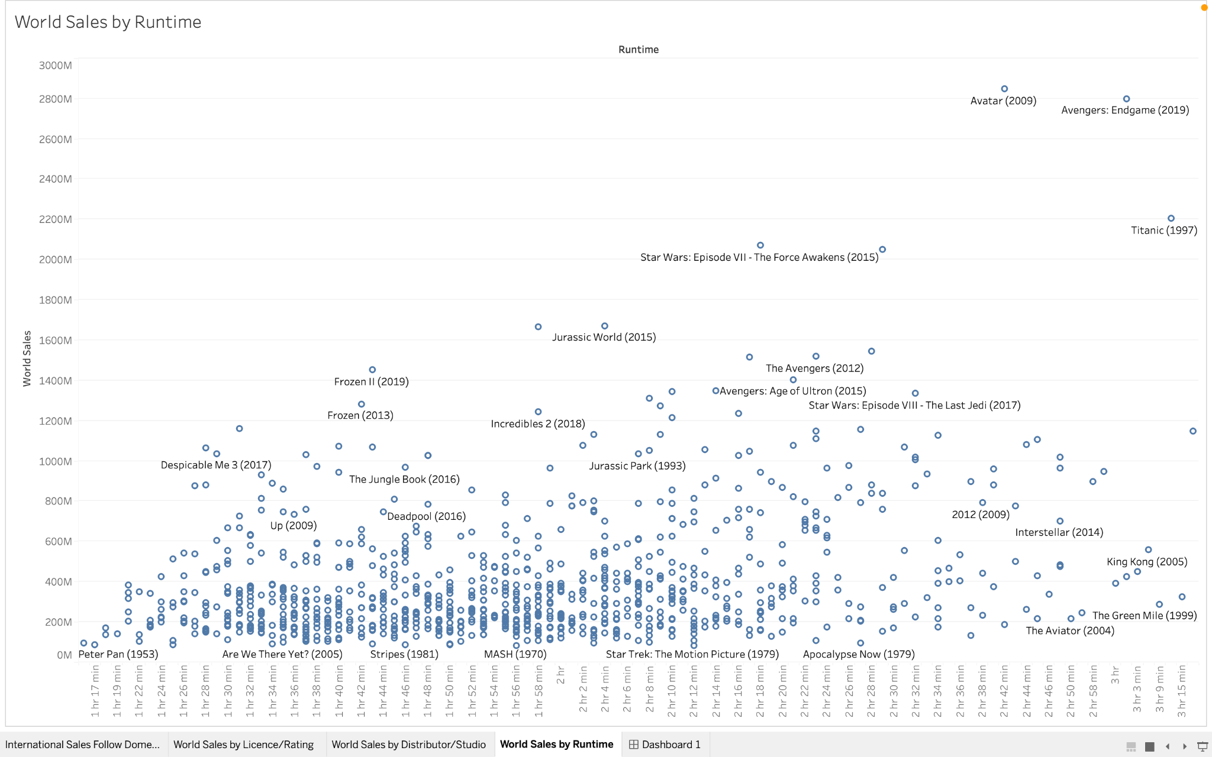
Short to Medium Length Films Preferred

Slide 9
Outliers:
Heavy Hitters Buck Trend
Long awaited franchise films (Avengers: EndGame)and big budget Oscar-bait (Avatar, Titanic) can be close to 3 hours long and still pull in some of the highest sales on record

Slide 10
Recommendations Based on Findings:
Balance Quantity & Quality
Keeping the bulk of our portfolio as short to medium length films allows for riskier bets on big-budget movies-of-the-year

Slide 11
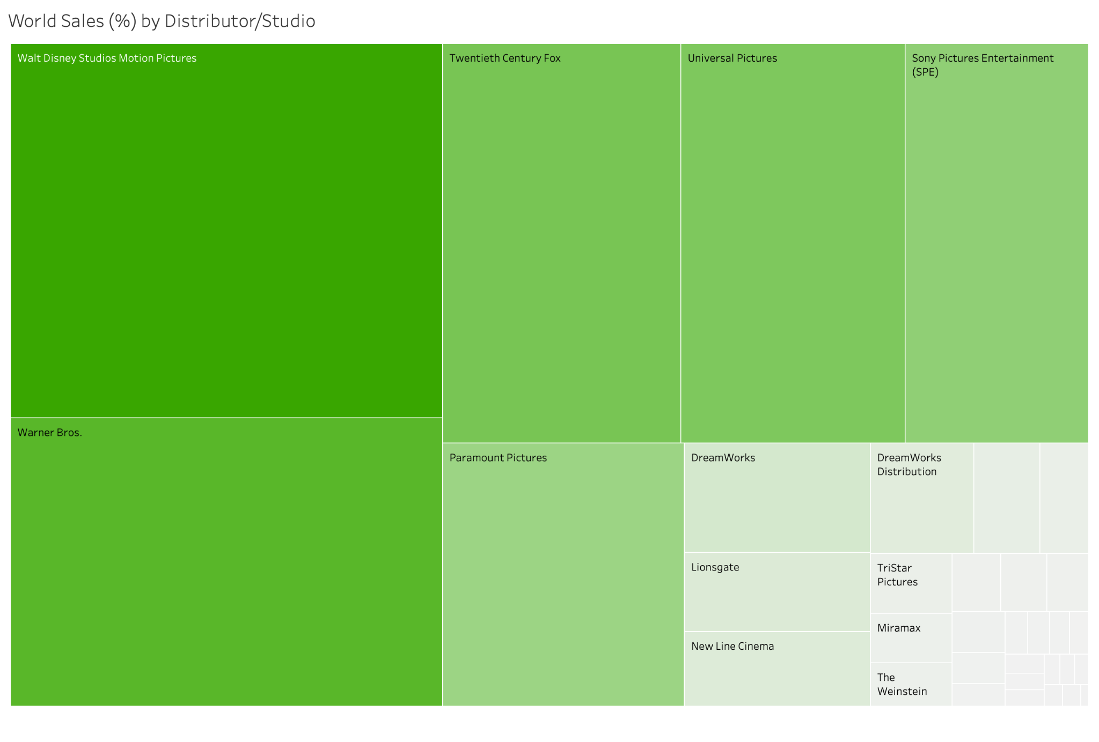
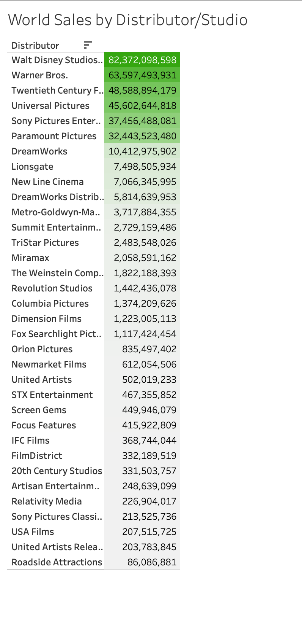
Top Studios Dominate Sales

Slide 12
Outliers: None
Stay Mainstream
Work with the major 5-6 studios as their economies of scale and brand-power momentum have solidified their power in continuing to produce the highest grossing films of all time
Recommendations Based on Findings:

Slide 13
How Our Hypotheses Held Out VS the Data:
American Influence Remains Strong (✅)
“Goldilocks” Ratings (✅) & Runtime (❌→🔍) Are Most Popular
A Handful of Studios Dominate the Box Office (✅)

Slide 14

Contributors
​​
Ricardo Gawlinski
Sebastien Hart
Qawiyy (Korweey) Rabiu

Slide 15

END

